Slide 1
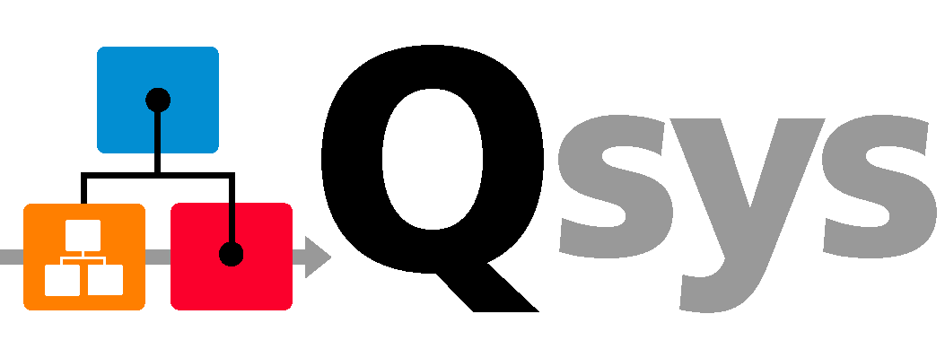
Introducing Qsys – Next Generation System Integration Platform
AP Tech Roadshow

Slide 2
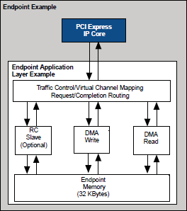
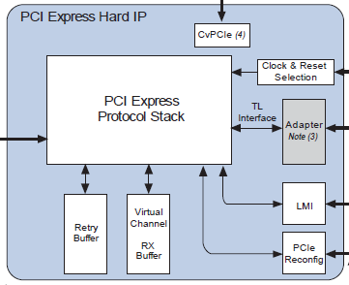
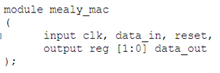


Raising the Level of Design Abstraction
System Level
IP Level
Design Productivity
Register
Transfer
Level
(RTL)
Gate Level
Level of Design Abstraction
Schematic
Entry
Quartus® II
Synthesis
SOPC
Builder
Increasing Level of Design Abstraction = Improving Productivity
Notes:
Improving productivity is a constant goal for FPGA designers. In order to go forward, we took a look backwards first. Taking a look back into history, we’ll see how Altera has improved FPGA designer’s productivity.
When FPGA designers first started out, they were developing designs at the gate-level. [Click]
As the need to improve productivity increased, designers moved to RTL. [Click]
As the need to improve productivity increased again, designers moved from RTL to IP-level development.
We are now at that crossroad again, as designers look for the next leap. [Click]
Qsys enables designer the next productivity leap up by raising the level of abstraction. Qsys enables designers to quickly develop large complex systems by integrating together other smaller complete systems and IP.
*******************
Backup
Qsys enables you to raise your level of abstraction, so you can be more productive at a system level.
<click next>
Do you remember the days when you had to use schematic tools to integrate low level design blocks, including low level primitives, RTL-level description or megafunctions? Then Altera introduced SOPC Builder, and you had a tool for building systems by integrating IP functions. Now with Qsys, you can go beyond building a system of IP cores and, instead, build systems out of systems.
Given the capabilities of Qsys, we know how important it will be to have a wide portfolio of IP cores and reference designs. So Altera is committed to providing broad IP support and adding industry-standard interfaces in the future.

Slide 3
Agenda
Introduce to System Integration Tool – Qsys
5 Reasons to Switch from SOPC Builder to Qsys

Slide 4

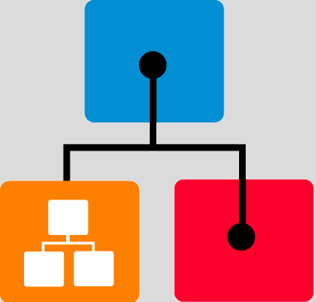




Qsys System Integration Platform
High-performance Interconnect
Hierarchy
System Verification
Based on Network-on-Chip architecture
Industry-standard Interfaces
Design Reuse
 | AXI3, AXI4
 | Avalon interfaces
Package as IP
Design
System
Add to
Library
(design reuse)
Qsys is Altera’s design environment for
  Deployment of IP
  Deployment of reference designs and example designs
  Development platform for Altera custom solutions
  Design platform for customers to quickly create system designs
Notes:
Qsys is a system level integration tool that is available in Altera Quartus II software. Qsys is based on the successful SOPC builder tool and delivers many key new features and benefit to address today’s FPGA design challenges. Including High-performance Interconnect, Industry-standard interface, Hierarchy, Design reuse support, and system verfication.

Slide 5
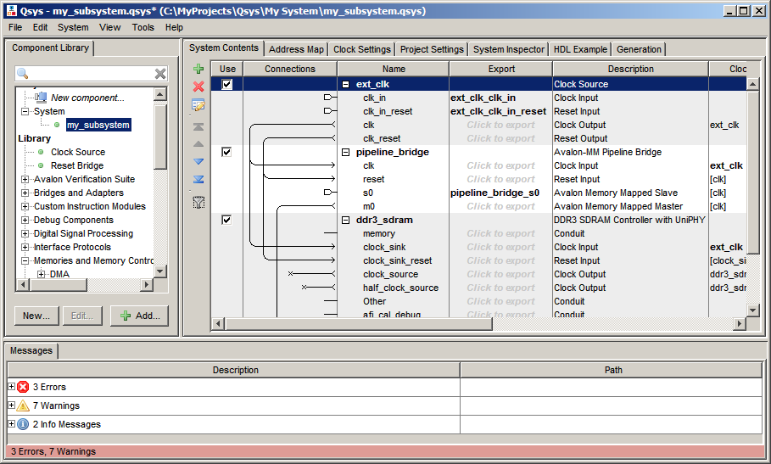
Qsys User Interface
New Tabs
Interfaces Exported
for Hierarchy
Toolbar
Improved Validation Display
Notes:
Here is the screen shot of the Qsys graphical user interface, as you may notes, it looks very similar to the SOPC builder user interface as well. We intentionally did this so that you easier for you to migrate from SOPC Builder to Qsys. However there are some new capabilities and new taps in Qsys. So let’s first start from our left handside the component library looks very similar to the SOPC Builder. On the bottom we have the messages panel as well to provide you any errors, warnings or info messages to your system and then on the main panel you have different taps that are available for you. So you have the system contents which shows you the connections of the IP components of your design. The address map, the clock settings, and there is project settings as well as system inspector tap. The system inspector provides you more detail information of how the interconnect has been generated in your Qsys design. In addition, there are toolbar icon available for you to easily generate your system

Slide 6
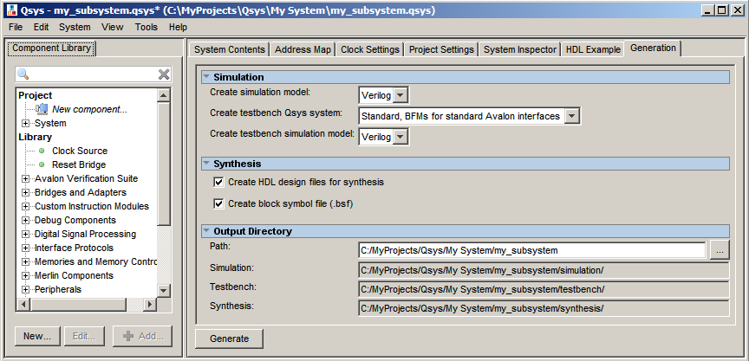
Quartus II Software Integration
You can generate your system from within Qsys
  Use Generation tab to create your system’s synthesis HDL files
  Add the .qip file to your Quartus II project
    .qip file lists the generated HDL files
Notes:
After you completed your Qsys design by connecting all your Ips together, you can use the generation tap in Qsys to generate the synthesis HDL files that can be used for compilation. This can be easily done by adding the .qip file to your Quartus II project. The .qip file content all of the generated HDL files

Slide 7
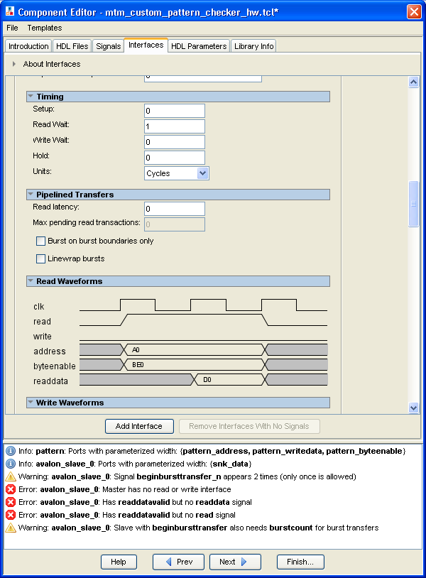
Component Editor
Create reusable Qsys components
  Import HDL and associated files (e.g. *.sdc)
  Define interfaces and signals
  Specify parameters/generics
  Add simulation files
  Include datasheet or user guide
Benefits
  Creates your own reusable custom components
    Includes Avalon interface templates
  Validates user HDL design during import
  Creates parameterizeable HDL components
    Based on Generics or Parameters in
    the VHDL or Verilog source code
  Output is _hw.tcl: TCL script describing component and its interfaces
Notes:
The Qsys component editor is a GUI that allows you to define a component and its parameter editor GUI. After you define your component in the component editor the component is available in the component library

Slide 8
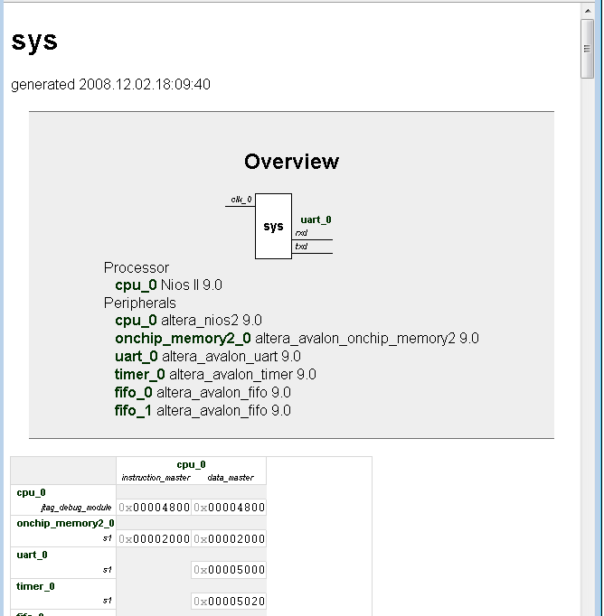
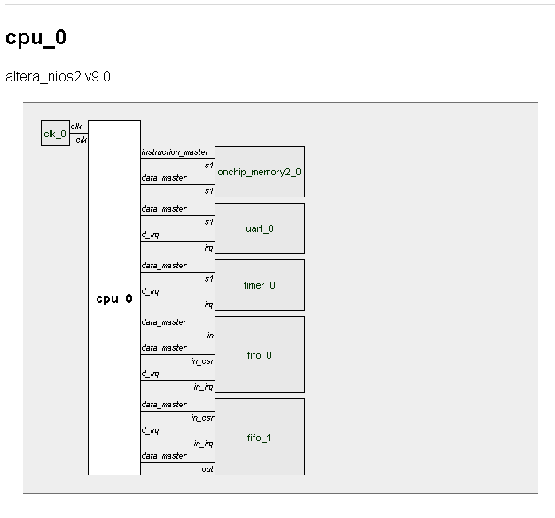
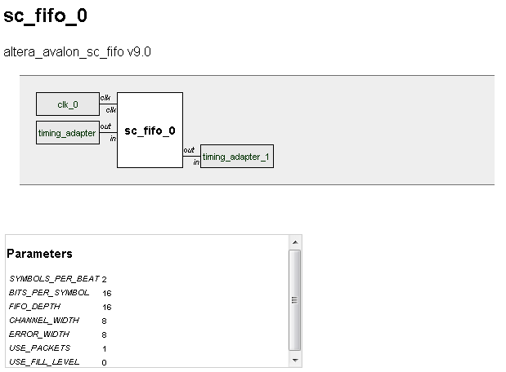
Data Sheet Document
Generates an HTML document describing your Qsys system
  Similar to a processor data sheet
  Shows system connectivity and component parameters
Benefits
  Eases design review process
  Serves as hand-off between hardware and software engineers
Notes:
Qsys system generation creates HTML datasheet for the system which provides a system overview including the
following information:
■ All external connections for the system
■ A memory map showing the address of each Avalon-MM slave with respect to
each Avalon-MM master to which it is connected
■ All parameter assignments for each component

Slide 9
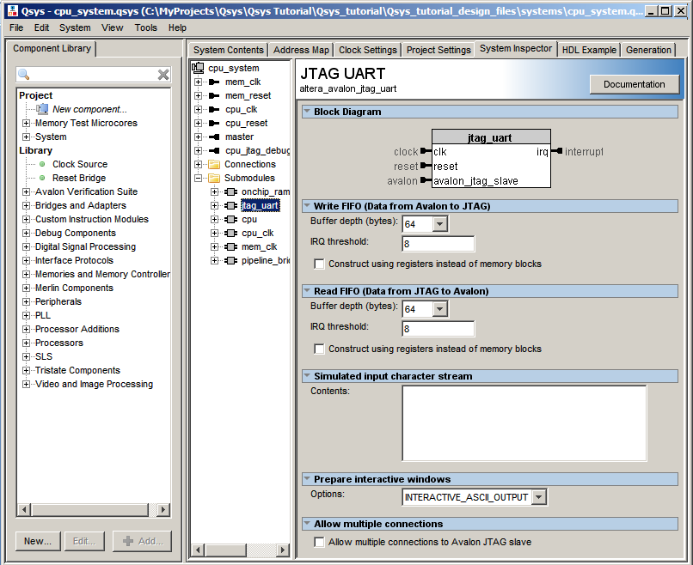
System Inspector
Use System Inspector to examine the details of the design blocks in the system
  Displays details on components in your design
  Can edit component parameters of your system
Notes:
The System Inspector tab displays the underlying model of your complete system.
You can use the System Inspector tab to review and change component parameters and to review interface timing.

Slide 10
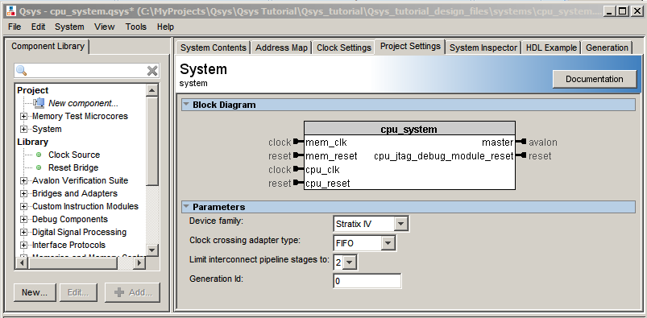
Project Settings
Use Project Settings to control your interconnect implementation
  Levels of latency (Pipelining of Qsys interconnect)
  Clock crossing adapter
    Handshake, FIFO or Auto
Control latency
Notes:
You can use the Project Settings tab to view and change the properties of your Qsys system.

Slide 11
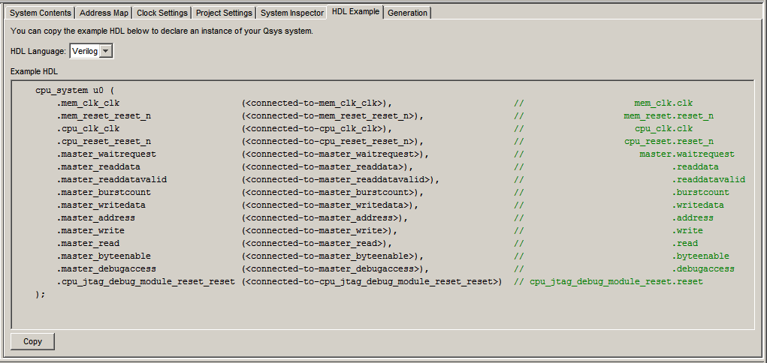
Qsys – HDL Example
HDL instantiation template for insertion into your design
  Verilog or VHDL
Notes:
The HDL Example tab provides the top-level HDL definition of your Qsys sytem in
either Verilog HDL or VHDL. This tab also displays VHDL component declarations.

Slide 12
5 Reasons to Switch from
SOPC Builder to Qsys
Notes:
If you are currently using SOPC builder, this section will show why switching to Qsys benefits you.

Slide 13
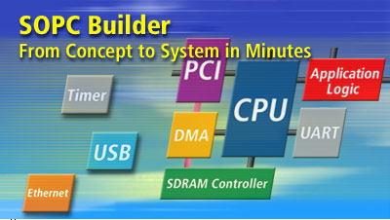

Qsys – Next-Generation System Integration Tool
Successful SOPC Builder
  First-generation system development tool
  Great success since 2002
    Over 10,000 embedded users
Qsys is the next generation of SOPC Builder
  Delivers next-generation capabilities
    Higher performance
    Hierarchy support
  Similar easy-to-use GUI
Similar GUI with More Capabilities
Notes:
SOPC Builder has had a great success since launch in 2002, and has been used by more than 10,000 embedded users around the world. As successful as SOPC Builder is, design engineers are stretching the limits of SOPC Builder by demanding higher performance, a more scalable system tool, more IP use, and larger feature-rich reference designs. And, as you know, there are also time-to-market pressures and limited resources to address.
Qsys represents the next generation of SOPC Builder. This new tool is tailored to satisfy the most demanded feature requests we’ve received for our system-integration tool. A few highlights include:
Higher system performance through the new Qsys system interconnect fabric
Hierarchy support, which will help you create more scalable systems and create a custom subsystem/IP library for future design re-use
The Qsys GUI is similar to the GUI that you know from SOPC Builder. And Qsys is also just as easy to use, even with the new capabilities!

Slide 14



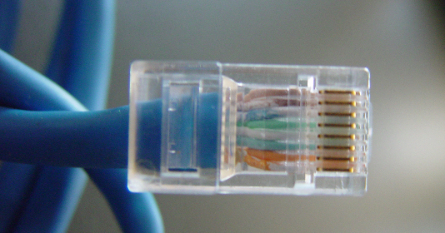
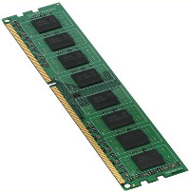
Qsys with Broad IP Support
Qsys supports a wide range of intellectual property (IP) functions
  Processor IP
    e.g. Nios® II e/f/s cores
  Embedded IP
    e.g. JTAG, UART, SPI, RS232
  Interface protocol IP
    e.g. PCI Express® (PCIe®), TSE
  Memory IP
    e.g. DDR / DDR2 / DDR3 SDRAM
  Video and image processing IP
    e.g. Video and Image Processing (VIP)
    Suite including scaler, switch,
    deinterlacer, and alpha blending mixer
Over 100 IP Supported in Qsys Now
Notes:
First question comes to mind for this next generation tool is IP support. Altera has been working hard to make sure your broad IP support is there with this Qsys system integration tool. Qsys compliant IP is what we would like to call it. You can see a logo for any compliant IP that Altera has verified to ensure the IP integrates with Qsys.
In the embedded IP world, Nios II software processors, JTAG, UART, SPI, and RS232 are ported over to be compliant. Many of the popular interface protocol or memory IPs were made to compliant with Qsys as well. Last, DSP video IP suites were also made to compliant with Qsys. It would include the scaler, switch and deinterlacer, alpha blending mixer IPs.
In Summary, Qsys now has over 100 IP component support and more compliant IPs will be available. To check the status of IP you are using, you can check online IP section or read the release note of Quartus II software. Remember to look for the Qsys compliant logo if you search online.

Slide 15
Top 5 Reasons to Switch to Qsys
Higher performance: New interconnect based on network-on-a-chip (NoC) architecture
Scalable systems: Design hierarchical systems
Industry-standard interfaces: Connect IP functions of different interfaces together (AXI etc.)
Design reuse: IP management capabilities
Faster board bring-up: Real-time system debug
Notes:
So what exactly is the performance and productivity enhancing technology we’ve integrated into Qsys? Well, it’s a combination of many new and exciting capabilities…and these capabilities provide great reasons for switching to Qsys:
First, a high-performance interconnect back on network-on-chip architecture
<click next> Second, new hierarchy support to enable scalable design
<click next> Then, support for industry standard interfaces
<click next> Qsys also has new IP management capabilities for design re-use
<click next> Last, new real-time system debug for faster board bring-up
Let’s dive a little deeper into these 5 features.

Slide 16


1. Higher Performance
SOPC Builder
Qsys
Manual Pipelining
System Interconnect Fabric
Medium
Low
High
Off
Qsys Interconnect
(Based on NoC
Architecture)
Up to 2X Higher Performance
Notes:
First, higher performance. This is simple and easy to understand. As engineers, we’re always wanting to achieve higher performance in our designs. Here are the reasons why Qsys supports this.
With SOPC Builder the fabric was a black box and the only way to improve the performance of your system was to manually add pipeline registers between your components and the fabric. <click next>
With Qsys, you can increase your performance up to 2x from SOPC Builder based on a new network-on-chip architecture and automatic pipelining feature for more intelligent interconnect. <click next>
In Qsys, the automatic control will generate automatic pipeline stages. The flexibility of the Qsys interconnect, based on a network-on-chip architecture, enables Qsys to automatically insert pipeline registers into the interconnect to achieve nearly double the fmax performance compared to SOPC Builder. <click next>
Then, to further optimize performance, there is a user-controlled dial that allows you to increase performance by trading off latency. As you increase performance, pipeline stages are added into the interconnect.
<click next>
<click next>
Qsys allows you to make trade off decisions between fmax and latency to meet the system requirements of your end application and has interconnect performance up to 2x compared to SOPC Builder.

Slide 17
Qsys Performance Example
Reference to Qsys white paper
  Applying the Benefits of NoC Architecture to FPGA
  System Design
Design example performance result
  16-Master/16-Slave System: Performance Results
Interconnect Implementation | f_{MAX} (MHz) | Resource Usage (ALMs)
Traditional interconnect | 131 | 12766
Qsys NoC, fully combinational | 161 (+23%) | 13999 (+10%)
Qsys NoC, 1 cycle network latency | 225 (+71%) | 11260 (-12%)
Qsys NoC, 2 cycle network latency | 243 (+85%) | 12761 (+0%)
Qsys NoC, 3 cycle network latency | 254 (+93%) | 14206 (+11%)
Qsys NoC, 4 cycle network latency | 314 (+138%) | 26782(+110%)
Qsys Improves Performance Up to 2X
Notes:
I also want to quickly reference to a published Qsys white paper with a design example for performance benchmark data. Please reference to this Qsys white paper named “applying benefits of network on a chip architecture to fpga system design” for more details.
This design example is built with 16-master/16-slave and is fully connected with a total of 256 connections. The
simple master and slave IP components exist only to test the characteristics of the
interconnect, meaning that the system is representative of a completely homogenous
system, and not a typical embedded system. This data table shows the
frequency and resource utilization results of the traditional interconnect and different
latency options of the NoC implementation. This data shows Qsys interconnect performance is up to 2X faster than SOPC Builder interconnect with 4 cycle network latency.

Slide 18
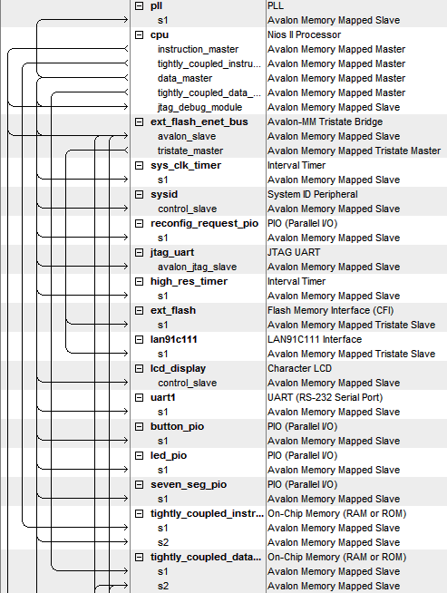
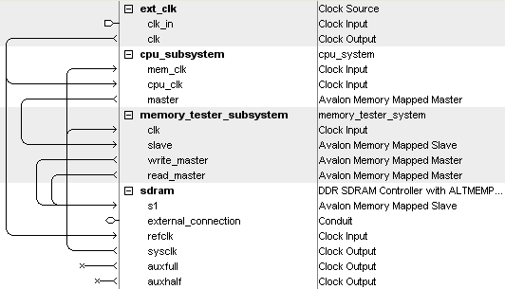
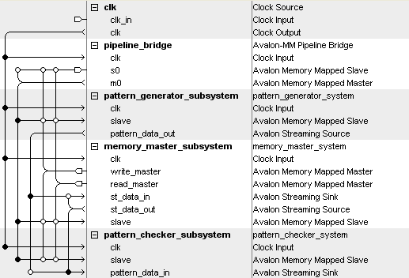
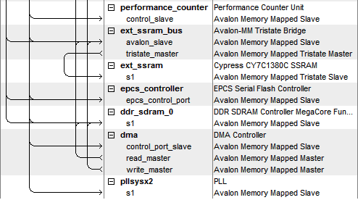
2. More Scalable Design
SOPC Builder
Qsys
Subsystem
Design with hierarchy
  Easily scalable with subsystem designs
  Fewer components = Faster GUI response and more
  manageable design
Notes:
Lets move to another important feature that supports more scalable design. The higher the number of components, the slower the GUI….and it becomes a challenge to manage your system (for example editing and changing parameters for a large SOPC Builder system with 200 components). Qsys enables hierarchical design, so you can create small sub-systems and integrate them together to create a larger system.
Qsys supports developing hierarchical systems by enabling you to complete a system today, and in the future, add an entirely new sub-system. By dividing a system into different sub-systems with hierarchy, you can easily manage each sub-system. Also the entire system doesn't need to be planned all at once, which gives you room for growth. With Qsys, you can add additional systems to your design with minimal impact to existing systems.
In this case, I’ve divided my system into two sub-systems and, as you can see, there are fewer number of components displayed with each sub system. This makes the GUI respond faster and the system becomes more manageable, which enables you to scale the system. If I want to edit one subsystem, I simply open up the Qsys subsystem design and I can start editing a subsystem in the same GUI. <click next>
Qsys raises the level of design abstraction by allowing you to integrate smaller systems together to create a larger system.

Slide 19


3. Industry-Standard Interfaces
Qsys supports mixing of different interfaces
Example System
Master
1
P
P
Slave
1
Avalon
A
A
Avalon
C
C
K
K
E
E
T
T
Master
2
P
P
Slave
2
Avalon
A
A
Avalon
C
C
K
K
E
E
T
T
Master
3
P
P
Slave
3
AXI
A
A
AXI
C
C
K
K
E
Qsys Interconnect
E
T
T
Developer | Standard Interface Protocol
 | Avalon® Interfaces
 | AMBA® AXI3*, AXI4*
®
*AXI3 and AXI4 support in 2011+
Design with Standard Interfaces
and Let the Tool do the Rest!
Notes:
IP cores use industry standard interfaces to help you more easily integrate them together. However, IP vendors, FPGA vendors and designers like yourselves may all have many different industry standard interfaces to choose from. How will system integration tools support such broad availability of IP cores when so many standard interfaces are used?
Altera is committed to deliver more industry standard interfaces in addition to our existing Avalon interface support. For example, we’re planning to support the AXI interface in 2011/2012 and other new support are in our roadmap.

Slide 20


4. Reuse Complete Subsystems
Project C
Qsys System
Project A
Reused as
Subsystems
Project B
Foo
Foo
Qsys Subsystem
Qsys Subsystem
Accelerate Development by Reusing
Subsystems
Notes:
**** design resue for subsystem
Qsys facilitates the design reuse process by adding your subsystem IP automatically into the IP library list available within Qsys for your team and others to use. <click next>
Any subsystem generated from Qsys can also be reused in the same or different project. This design reuse capability allows you to accelerate development and maximize design reuse to reach higher productivity.

Slide 21
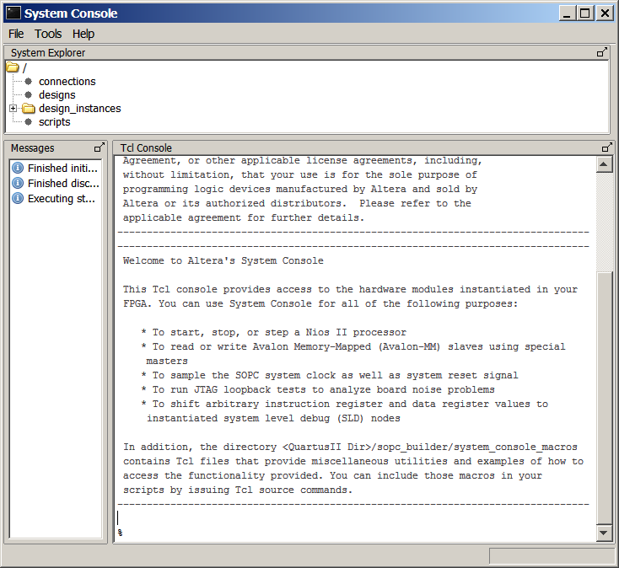
5. Faster Board Bring-up
On-Chip Debug
  Time consuming to tap 100’s of registers and analyze large amounts of data
Qsys accelerates verification with read and
write transactions
  Read and write to registers and memories instead of tapping each
  individual registers
System Console
FPGA
A
Bridge
IP
View Data
in Real-Time
JTAG Bridge IP
TCP/IP Bridge IP
B
C
D
Faster Board Bring-Up with Real-Time
System Debug
Notes:
Qsys also introduces a new approach to system level real-time debug.
In SOPC Builder today, you have to use SignalTap II, SignalProbe or In-system Memory Update to tap or probe a particular signal before compiling. It takes additional planning and setup, compared to Qsys’ system level verification approach. More compiles are needed to change existing setup and reading individual registers is time-consuming. <click next>
Qsys enables faster board bring-up by allowing you to access the system in real-time with reading/writing transactions through a bridge IP. You can now access the entire system, remotely debugg with TCP/IP and perform reads / writes to status registers instead of accessing individual registers and nodes.
So, these are the top 5 features for migrating to Qsys. Next, lets go through details on how to get started.

Slide 22
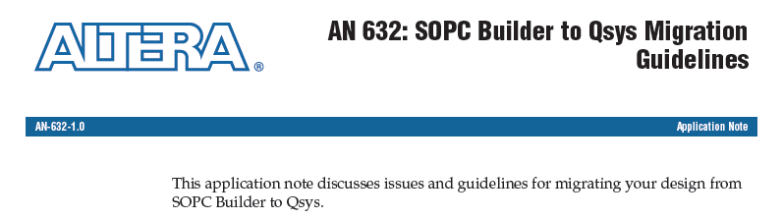
Qsys Migration Documentation
AN632: SOPC Builder to Qsys Migration Guidelines
  Highlights guidelines and issues for Qsys migration
    Examples
      Automatic interconnect upgrades
      New tristate implementation
      Manual IP update
      Manual Synopsys Design Constraints
      (SDC) update
      Manual .ptf update
Software release notes
  Latest update for Qsys support
Migration online video demo
  Demo migration of a simple design
Notes:
Before using Qsys, be sure to read some migration documentations to save your migration efforts. First,
review the Quartus II Software Release Notes and the SOPC Builder to Qsys Migration Application Note for known issues and limitations. It highlights guidelines and issues for Qsys migration. Some examples are: Qsys will automatically upgrade your system interconnect to improve performance. New tristate are implemented to further enhance interconnect performance. Key IPs including Nios II processor and its peripherals are automatically migrated.
Common Migration issues are a few required manual updates. You may need to delete an existing IP and replace it with the latest Qsys compliant IP. For example, UniPhy and PCIe IPs are required to go through manual updates to utilize Qsys benefits. You may also need to manually update SDC constraints because signal names may have changed. Old sopc builder file in PTF just wont migrate as well and it is another manual steps to go through during migration.
Be sure to read software release notes and get latest updates for Qsys support in feature and IPs.
Last, if you haven’t or not planning to, watch a quick migration online demo to see a quick migration from SOPC Builder.
If you still have more concerns or issues, you can access to existing support channel including both my support.altera.com or contact Altera FAE.

Slide 23
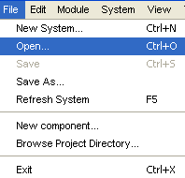
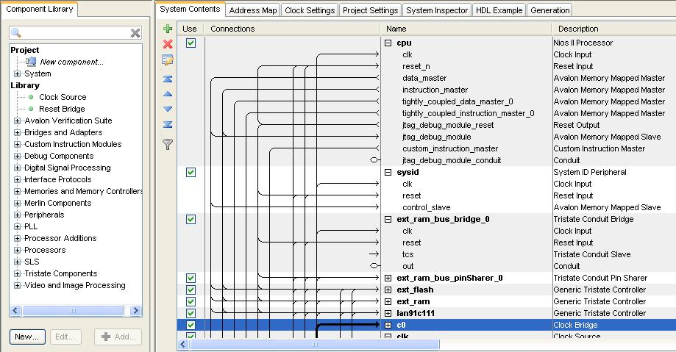
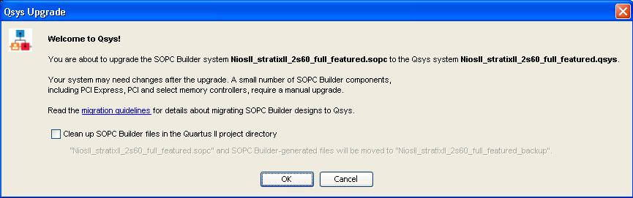
How to Start: Switch to Qsys
Step 1: open existing SOPC Builder system
  Qsys is backward compatible with .sopc file
Step 2: save design file
  Automatically convert files to Qsys design files
Step 3: follow the guideline in Qsys migration application notes and release note.
Open File
Qsys Migration Dialog
Familiar GUI in Qsys
Notes:
In the migration online demo, it shows you how to get started with switching to Qsys. There are two simple steps. First, you simply open an existing SOPC Builder system. Qsys is backward compatible with .sopc file and you will be promoted with a migration dialog box. Click ok to proceed and you will find your existing SOPC Builder system ported to Qsys in a familiar GUI environment.
Then, you can save your design file in .qsys to finish .sopc file conversion to .qsys file. Be aware of the manual steps you have to go through mentioned in Qsys migration application note and release note. I hope you find Qsys migration intuitive and please share with us your successful migration and performance enhancement in Qsys.

Slide 24

Conclusion
Qsys is the next generation of SOPC Builder
  Similar GUI with more capabilities
Top 5 reasons to upgrade
  Higher performance
  More scalable design
  Broad IP support with
  industry-standard interfaces
  Improved design reuse
  Faster board bring-up
Notes:
In conclusion, Qsys is our next generation of SOPC Builder that delivers more capability using similar GUI.
There are many benefit of evaluate and migrate to Qsys.
1.) higher interconnect performance is delivered with new Qsys system interconnect fabric. You can tweak the trade-off between fmax and latency.
2.) more scalable design - Qsys allows you to create subsystem and bundle IPs. This allows you to navigate design tool GUI more easily and enables easier design reuse.
3.) broad ip support with industry standard interfaces – Qsys supports Avalon interface and is planning to support AXI. Broad IP support is planned to ensure you are fully equipped for migration.
4.) improved design reuse – Qsys will save your system design in a new file called .qsys and you can create a custom IP or subsystem library.
5.) faster board bring-up – Qsys provides a system level verification interface IP and helps in designs bringing up new boards.
With these existing new benefits, I hope it justified your valuable time and start your migration to Qsys. Feedback is appreciated as Altera is striving to deliver Qsys to your expectation.

Slide 25
Next Step
Qsys Virtual Training
  Qsys online demos (3min ~ 5min each)
    Increase Interconnect Performance with Qsys
    Design a Hierarchical System with Qsys
    Move Your Design from SOPC Builder to Qsys
    Start Design Simulation Faster with Qsys
    Cut On-Chip Debug Cycles Using Qsys
  Qsys webcast
    Conquer FPGA Design Complexity with System-Level Integration
    Easily Create PCIe®-Based Designs for FPGAs
  Tutorials and Training
    Qsys Tutorial: Step-by-step procedures to design a simple memory test subsystem in Qsys
    System Integration with Qsys: 2-day instructor-led class
  Qsys white paper:
    Applying the Benefits of Network on a Chip Architecture to FPGA System Design
Qsys available in Quartus II software
  Subscription Edition (30-day free trial)
  Web Edition (FREE)
Notes:
Last, lets close with your next steps.
1.) As I mention, there are video demos for you to learn more about the new features including higher performance and hierarchical design demo.
2.) There is also training and tutorial available. Please make sure you attend training or go through the tutorial.
3.) Last, Qsys is available in both subscription edition and web edition. Download latest Quartus II Software and get a Qsys productivity boost in your system design today!

Slide 26
References
System Design with Qsys (PDF) section in Quarters II Handbook
AN 632: SOPC Builder to Qsys Migration Guidelines for known issues and limitations
Resource Center: http://www.altera.com/support/software/system/qsys/sof-qsys-index.html

